Slide 1


Infection prevention and control of COVID in ports

Slide 2
Overview
How are diseases transmitted from person to person?
What are the principles of infection prevention and control
What IPC measures are other countries / organisations recommending for the transport industry/workers?
How can we apply this knowledge to protect us while we protect our country?
  Administrative controls = screening and awareness, people flow, health promotion
  Environmental controls = ventilation, airflow,
  Personal protective equipment = use of masks, gloves, hand hygiene

Slide 3
How are diseases transmitted from person-to-person?

Slide 4
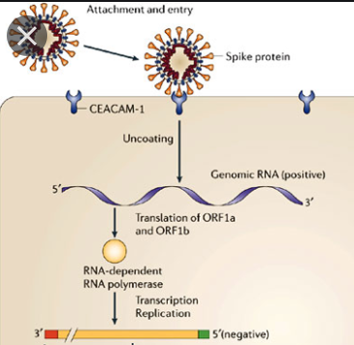
How are diseases transmitted from person-to-person?
Before causing disease, a bacterium or virus must ATTACH to a cell
Viruses attach to specific proteins on the surface of human cells
After attachment, they are able to enter the cell and cause disease.
The site of the specific receptor tells us how the organism is transmitted.

Slide 5
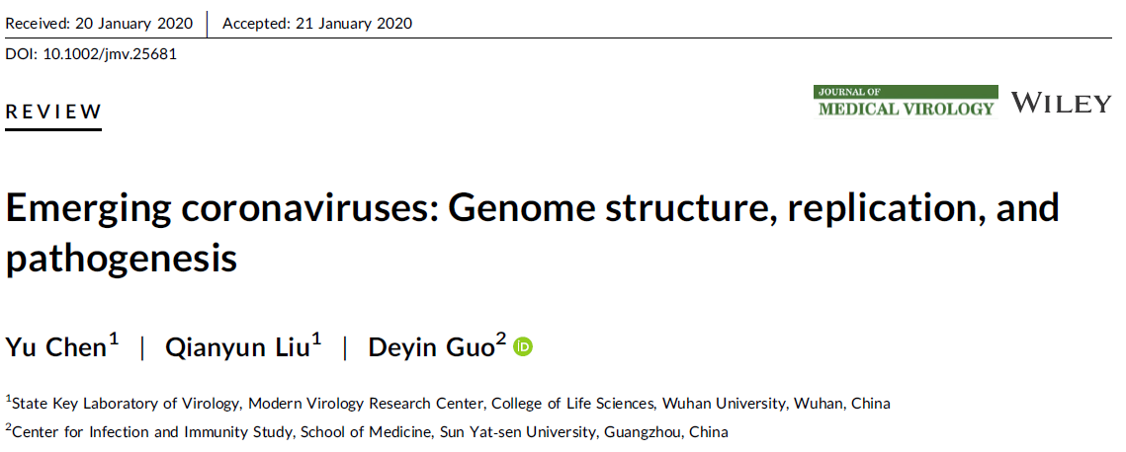
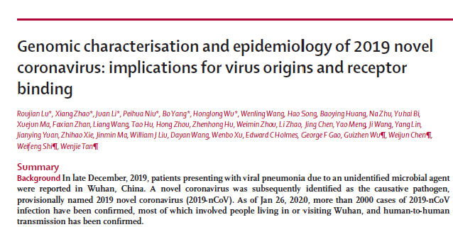
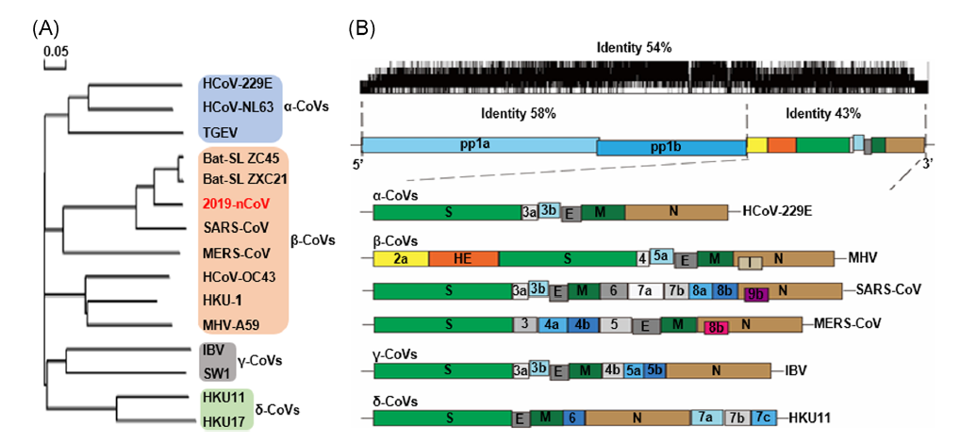
How is coronavirus transmitted from person-to-person?
Already (!!) researchers have understood that SARS-CoV-2 is very much SARS-CoV-1 (cause of SARS outbreak in 2003).
It most likely binds to the same cell surface receptor – angiotensin converting enzyme (ACE) which is found on cells surfaces in the respiratory tract

Slide 6
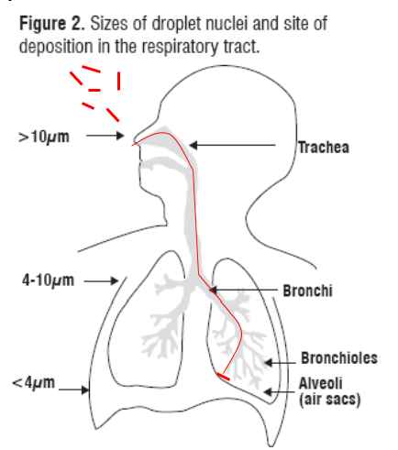
How are diseases transmitted from person-to-person?
Tuberculosis bacteria must attach to proteins on the surface of the alveolar macrophage
Therefore the ‘carrier droplets’ must be small enough to enter the alveoli
Coronaviruses of the beta-coronavirus clade must attach to proteins on the surface of epithelial cells in the upper and lower airways called angiotensin converting enzyme (ACE)
Therefore ‘carrier droplets’ need not be very small.

Slide 7
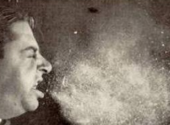
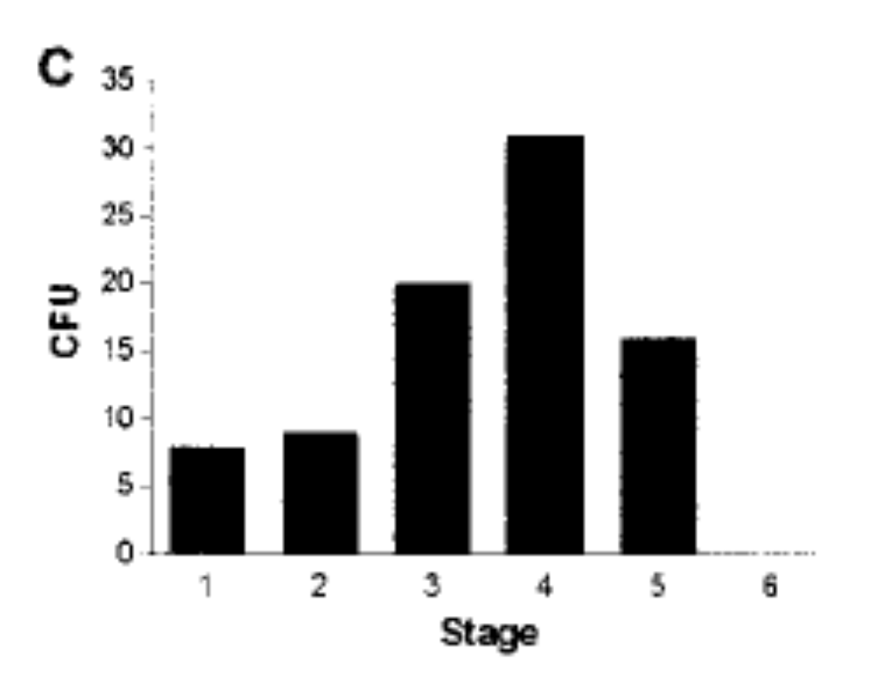
How are diseases transmitted from person-to-person?
Coughing generates droplets of different sizes
  Fennelly et al counted the number of particles of each size (histogram above) generated when a patient coughs
  They range from 7mm-0.65um
Larger droplets fall to the ground within a 1-2m radius of the person
Droplet nuclei that are small enough to enter the alveoli remain suspended in air for up to 12 hours.

Slide 8
How are diseases transmitted from person-to-person?
  The Wells-Riley equation
Risk of infection following exposure depends on
Particles
Volume
Exposure time
x
Particles:
Volume:
Exposure time:
Production of infectious droplet nuclei
Volume of air and ventilation
Duration of exposure to contaminated air

Slide 9
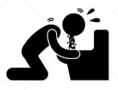

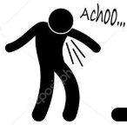

How are diseases transmitted from person-to-person?
Coronavirus
Airborne transmission
Inhaling droplets nurclei (10-20um in diameter)
Persons breathing the same air
E.g. influenza, measles, chickenpox,
Control
Gloves, N95 masks, +/- gowns, masks, visors (to prevent mucous membrane splashes, contamination of clothing)
Direct contact
Touching an ill persons or a contaminated surface
E.g. agents of diarrhoea, skin infections, common cold, ebola virus
Control
Gloves, +/- gowns, masks, visors (to prevent mucous membrane splashes, contamination of clothing)
Vector transmission
Contact with vector
E.g. malaria, dengue, Zika,
Control
Prevent/eliminate exposure to vector
Chemoprophylaxis if possible
Droplet transmission
Inhaling droplets (up to 1/4mm in diameter)
Persons within 2m radius are at risk. On aircraft, 2 rows behind and in front
E.g. agents of bacterial pneumonia, Neisseria meningitidis
Control
Gloves, surgical masks, +/- gowns, masks, visors (to prevent mucous membrane splashes, contamination of clothing)

Slide 10
How are diseases transmitted from person-to-person?
Coronavirus
Airborne transmission
Inhaling droplets nurclei (10-20um in diameter)
Persons breathing the same air
E.g. influenza, measles, chickenpox,
Control
Gloves, N95 masks, +/- gowns, masks, visors (to prevent mucous membrane splashes, contamination of clothing)
Direct contact
Touching an ill persons or a contaminated surface
E.g. agents of diarrhoea, skin infections, common cold, ebola virus
Control
Gloves, +/- gowns, masks, visors (to prevent mucous membrane splashes, contamination of clothing)
Vector transmission
Contact with vector
E.g. malaria, dengue, Zika,
Control
Prevent/eliminate exposure to vector
Chemoprophylaxis if possible
Droplet transmission
Inhaling droplets (up to 1/4mm in diameter)
Persons within 2m radius are at risk. On aircraft, 2 rows behind and in front
E.g. agents of bacterial pneumonia, Neisseria meningitidis
Control
Gloves, surgical masks, +/- gowns, masks, visors (to prevent mucous membrane splashes, contamination of clothing)

Slide 11
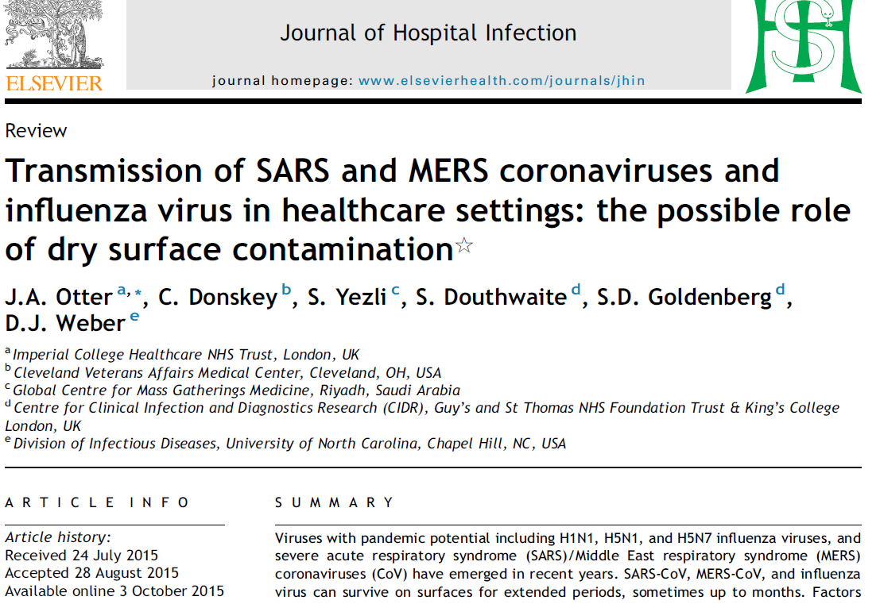
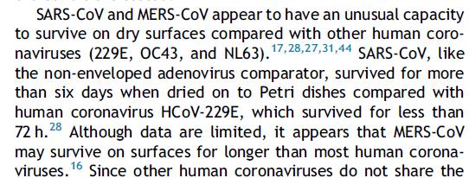

How are diseases transmitted from person-to-person?
Survival in the environment depends on
  pH
  Innoculum size
  Dryness
  Temperature
  Exposure to disinfectants

Slide 12
How are diseases transmitted from person-to-person?
Coronavirus
Airborne transmission
Inhaling droplets nurclei (10-20um in diameter)
Persons breathing the same air
E.g. influenza, measles, chickenpox,
Control
Gloves, N95 masks, +/- gowns, masks, visors (to prevent mucous membrane splashes, contamination of clothing)
Direct contact
Touching an ill persons or a contaminated surface
E.g. agents of diarrhoea, skin infections, common cold, ebola virus
Control
Gloves, +/- gowns, masks, visors (to prevent mucous membrane splashes, contamination of clothing)
Vector transmission
Contact with vector
E.g. malaria, dengue, Zika,
Control
Prevent/eliminate exposure to vector
Chemoprophylaxis if possible
Droplet transmission
Inhaling droplets (up to 1/4mm in diameter)
Persons within 2m radius are at risk. On aircraft, 2 rows behind and in front
E.g. agents of bacterial pneumonia, Neisseria meningitidis
Control
Gloves, surgical masks, +/- gowns, masks, visors (to prevent mucous membrane splashes, contamination of clothing)

Slide 13
Principles of infection prevention and control

Slide 14
Principles of infection control
  The Wells-Riley equation
Eradicate the particles by
Teach cough hygiene
Giving people who cough a surgical mask
Risk of infection following exposure depends on
Reduce each person’s exposure by
Early screening of cases
Triaging and seeing patients who cough first
Particles
Volume
Exposure time
x
Decrease the concentration of particles in the air by
Standing >1m from a person
Increasing the ventilation rate
Opening windows
Particles:
Volume:
Exposure time:
Production of infectious droplet nuclei
Volume of air and ventilation
Duration of exposure to contaminated air

Slide 15
Principles of infection control
Must therefore be achieved through elimination and control of these
‘infectious TB particles’
Decrease the number of particles formed by people with TB disease
Prevent people from inhaling the particles and reduce their risk of developing TB disease
Remove the particles from the air – ie clean the air

Slide 16
Principles of infection control
Create an enabling environment
Reduce formation of infectious particles
Remove infectious particles
Reduce risk of inhaling infectious TB particles and developing TB disease
Administrative
Controls
Environmental
Controls
PPE and risk
Reduction

Slide 17
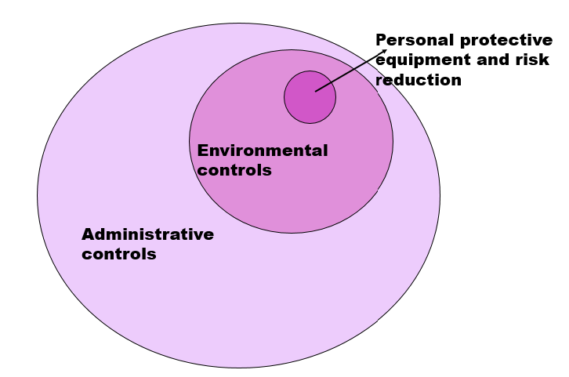
Ability to prevent transmission of infectious organisms
The relative ability of each component of IPC is shown by the size of the circle
Screening and triage (administrative controls) are most important
Environmental controls are important
PPE is the least effective

Slide 18
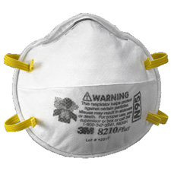
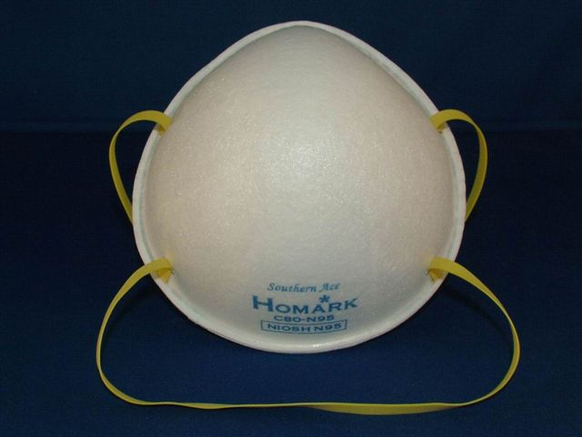
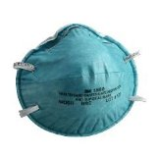
Principles of infection control
What is a N95 respirator?
  It is a filter which traps infectious particles and stops them from being inhaled.
  Masks which do this are called ‘particulate filter respirators’
  Droplet nuclei that are responsible for airborne transmission are 1-5μm in diameter.
  Masks that are able to prevent TB infection must capture particles this size and larger.

Slide 19
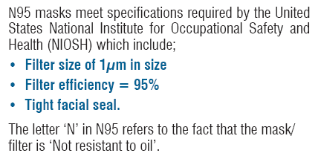
Principles of infection control

Slide 20
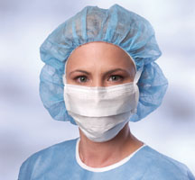
Principles of infection control
A surgical mask:
  Has only 50% filter efficiency – it only stops 50% of particles.
  It lacks a tight facial seal.
  It is useful to capture infectious particles coming from the person who is wearing the mask
  Surgical masks stop surgeons ‘spitting’ into the operating field!!

Slide 21
Principles of infection control
N95 respirators will NOT work if:
  They are not properly fitted
  If the wearer has facial hair (beard) preventing a proper fit
  They are damaged or crushed
  They are saturated (reused until the filter capacity has been exceeded)
  They get wet (even if they dry again).

Slide 22
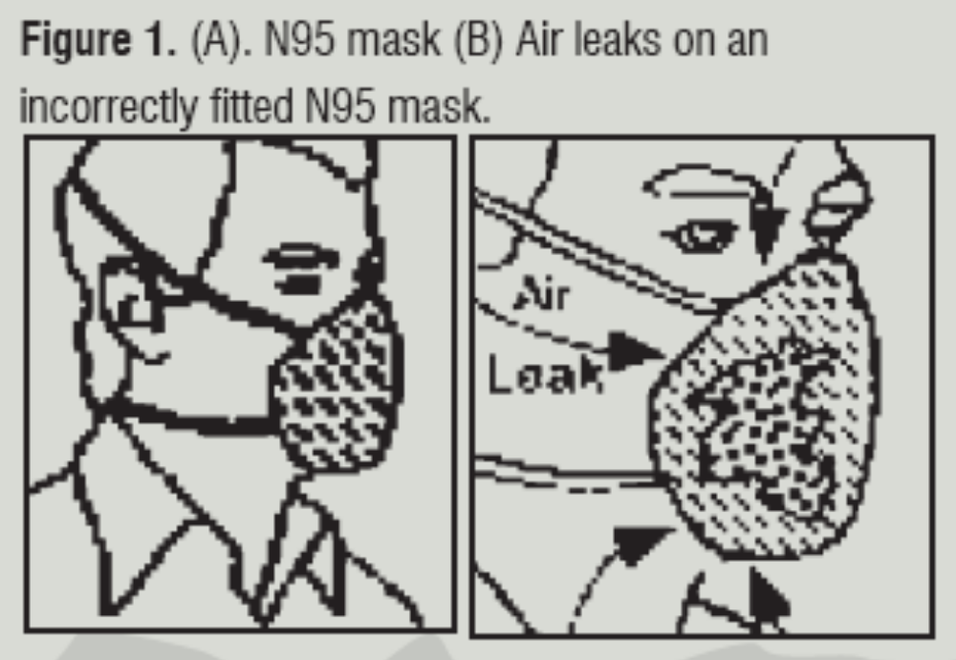
Principles of infection control
Fit the mask according to manufacturer’s instructions.
  Do not touch outside of mask on placing, and on removal
Once the mask is in place, inhale sharply. The mask should be drawn in towards your face, indicating that a negative pressure has been generated.
If the mask does not draw in towards your face, or you feel leakage at the edges, adjust straps by pulling back along the sides and/or reposition respirator.
Repeat until mask is sealed properly.

Slide 23
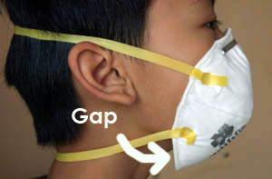
A badly fitted mask…

Slide 24
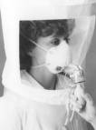
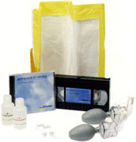
Objective ‘fit-test’

Slide 25
Principles of infection control
Who should use N95 masks, and where?
Where?
  Where airborne transmission is the dominant mode of transmission
  Where administrative and environmental controls cannot significantly reduce the risk to HCW
  Examples:
    Where newly diagnosed TB or TB suspects are seen
    MDR/XDR TB facilities
    Respiratory isolation facilities
WHO?
  Health Care workers
    (NOT patients!)
    Any cadre
  For protection of HCW from
    TB infection or
    airborne transmission or
    where there is intense risk of transmission (e.g. intubating or suctioning a patient in ICU)

Slide 26
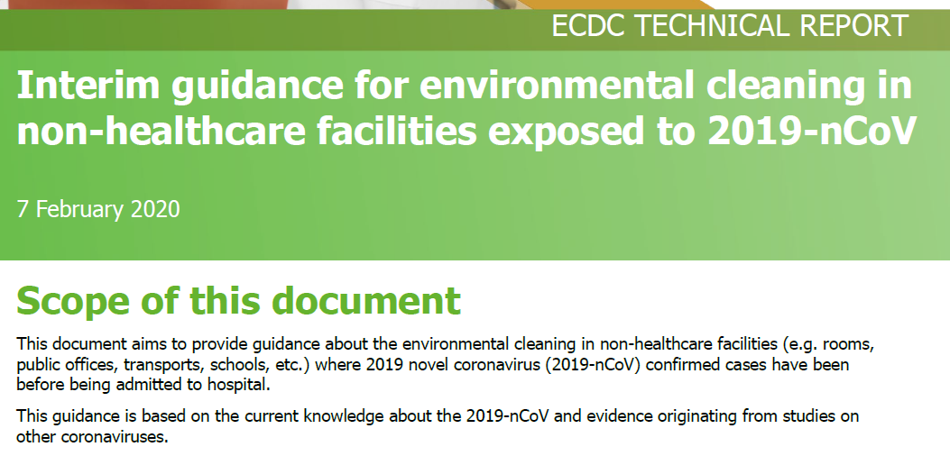
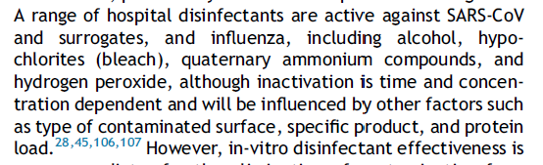
Principles of infection control
Cleaning and disinfection of the environment
  Hands – alcohol handsanitizer
  Environment
    General soap and water
    If contamination suspected, can use ethanol, bleach, quaternary ammonium compounds
    See ECDC reference document

Slide 27
How can we prevent transmission of SARS-CoV-2 in our work environment?

Slide 28
How can we prevent transmission of SARS-CoV-2?
Administrative controls
Environmental controls
Personal protective equipment/practice
Ensure ventilation is good, and aircon is working
Provide bins for disposal of tissues, masks
Stand away from people (social distancing)
Clean the environment
Screen everyone early
Use health promotion messaging re symptoms
Teach cough hygiene
Hand hygiene
Don’t touch face/mouth
Keep distance.
If can’t keep distance, use surgical mask and gloves

Slide 29
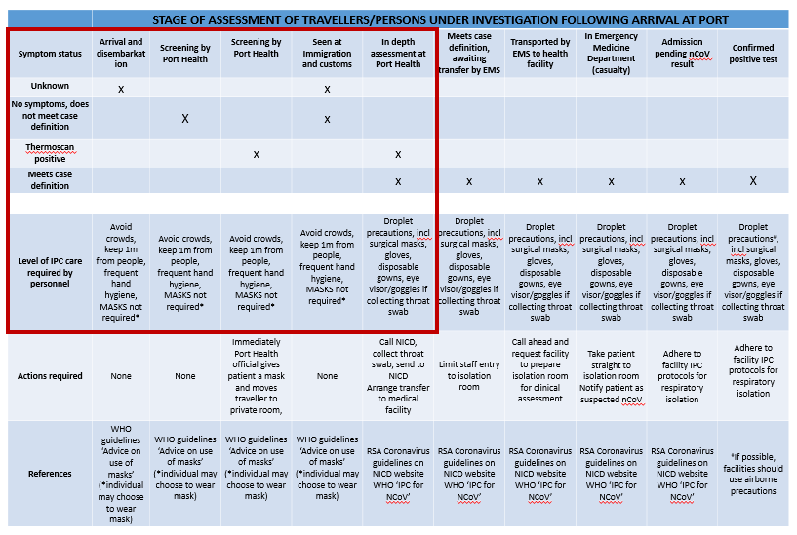
How can we prevent transmission of SARS-CoV-2?

Slide 30
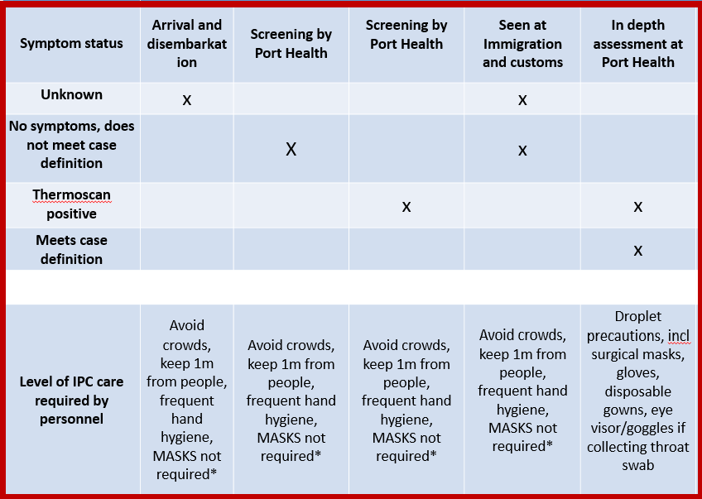
How can we prevent transmission of SARS-CoV-2?
Administrative controls
  Facilitate hygiene – soap, red bins etc
  Screen and triage early.
  Give people who cough a mask
When screening
  Don’t touch person – stand far from them
  Don’t touch mouth/eyes etc
  Wash hands / use hand sanitiser
  If using gloves/mask, use properly!!!
On identification of a symptomatic person
  Give them a mask
  Isolate them
  Use droplet precautions

Slide 31
How are other countries protecting port health officials?

Slide 32
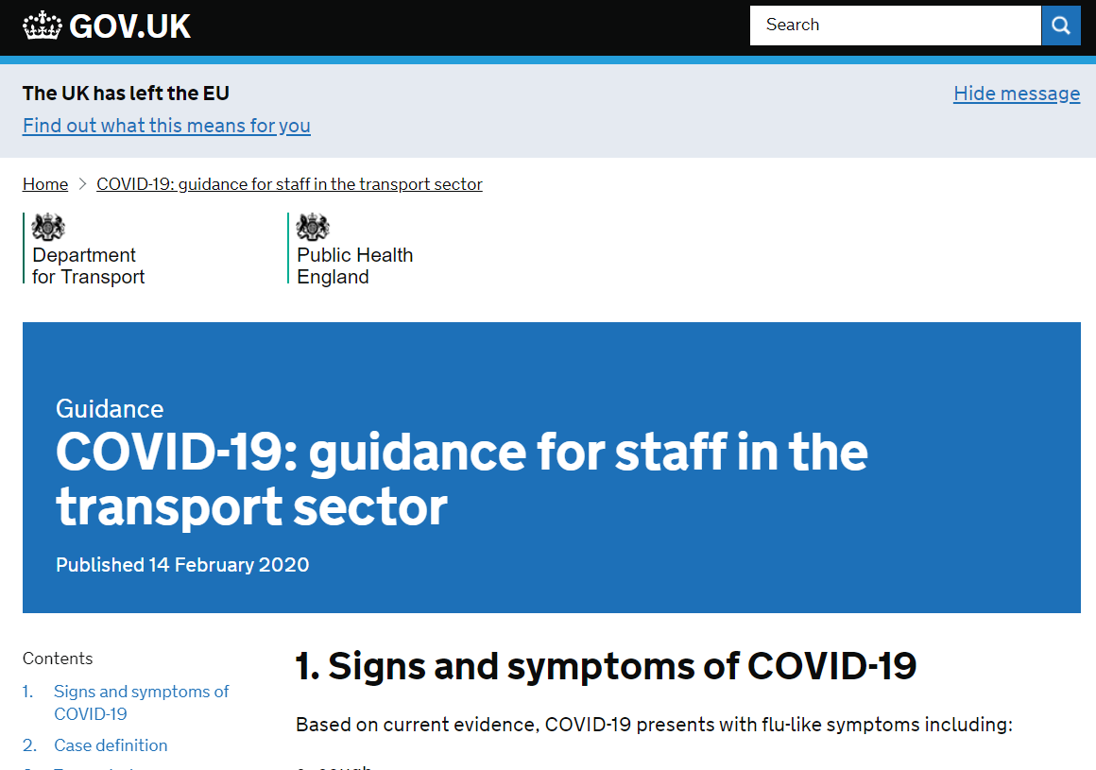
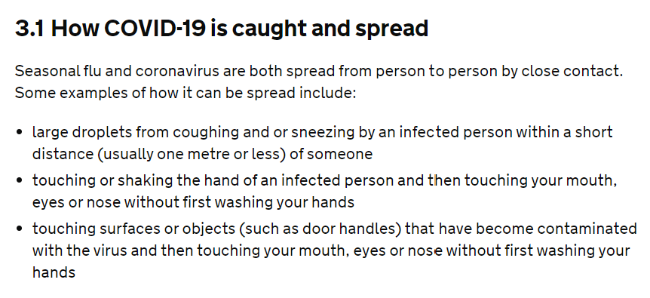
How are other countries protecting port health officials?
https://www.gov.uk/government/publications/covid-19-guidance-for-staff-in-the-transport-sector/covid-19-guidance-for-staff-in-the-transport-sector

Slide 33
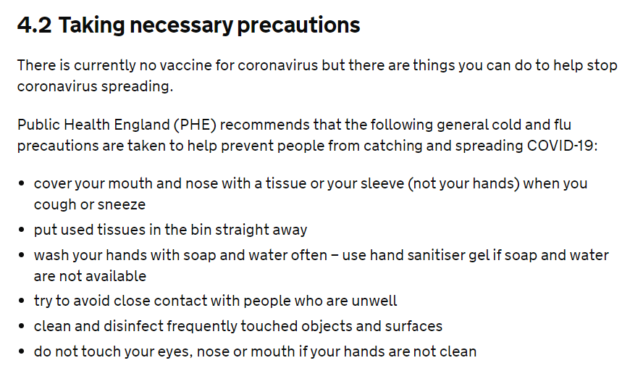
How are other countries protecting port health officials?
https://www.gov.uk/government/publications/covid-19-guidance-for-staff-in-the-transport-sector/covid-19-guidance-for-staff-in-the-transport-sector

Slide 34
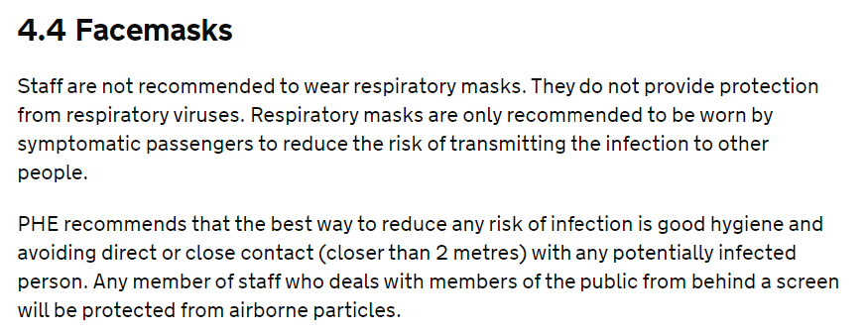
How are other countries protecting port health officials?
https://www.gov.uk/government/publications/covid-19-guidance-for-staff-in-the-transport-sector/covid-19-guidance-for-staff-in-the-transport-sector

Slide 35
Questions?
Public Hotline 0800-029-999

